Slide 1
A* algorithm

Slide 2
A* search algorithm
F(n)= g(n) + h(n)
G(n): cost from initial state to n
H(n): estimate cost to reach from n to goal
Arad to Bucharest example

Slide 3
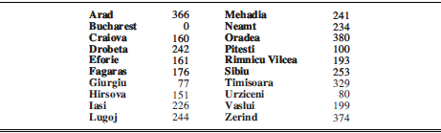
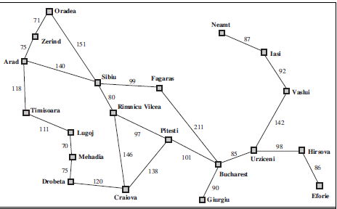

Slide 4
solution
ARAD
0 + 366 = 366
ZERIND
75+374=449
SIBIU
140+253=393
TIMI
118+329=447

Slide 5
solution
ARAD
0 + 366 = 366
SIBIU
140+253=393
TIMI
118+329=447
ZERIND
75+374=449
FRAGRAS
140+99+176
=415
ORADEA
140+151+380
=671
RIM
140+80+193
=413

Slide 6
solution
ARAD
0 + 366 = 366
SIBIU
140+253=393
TIMI
118+329=447
ZERIND
75+374=449
FRAGRAS
140+99+176
=415
ORADEA
140+151+380
=671
RIM
140+80+193
=413
PITESTI
140+80+97+100
=417
CRAIOVA
140+80+146+160
=526

Slide 7
solution
ARAD
0 + 366 = 366
SIBIU
140+253=393
TIMI
118+329=447
ZERIND
75+374=449
FRAGRAS
140+99+176
=415
ORADEA
140+151+380
=671
RIM
140+80+193
=413
PITESTI
140+80+97+100
=417
CRAIOVA
140+80+146+160
=526
BUCHAREST
140+99+211+0
=450

Slide 8
solution
ARAD
0 + 366 = 366
SIBIU
140+253=393
TIMI
118+329=447
ZERIND
75+374=449
FRAGRAS
140+99+176
=415
ORADEA
140+151+380
=671
RIM
140+80+193
=413
PITESTI
140+80+97+100
=417
CRAIOVA
140+80+146+160
=526
BUCHAREST
140+99+211+0
=450
BUCHAREST
140+80+97+101+0
=418
CRAIOVA
140+80+97+138+160
=615

Slide 9
Conditions for optimality
H(n) value less than true cost to goal ----admissible property
h(n) ≤ c(n, a, n’) + h(n’) --- consistency property

Slide 10
Missionary and cannibal problem

Slide 11
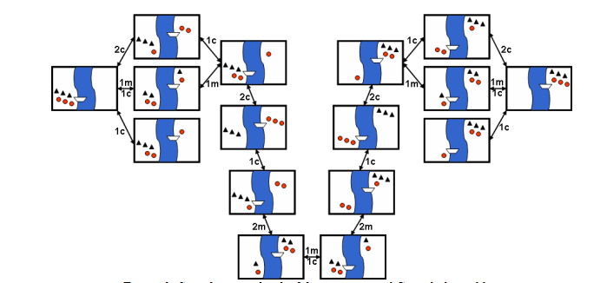
Missionary and cannibal problem-state space example

